Slide 1
Machine Learning in Python: Programming questions
Fengfeng Zhou
Email: FengfengZhou@gmail.com or ffzhou@jlu.edu.cn
HILab, JLU
Web: http://healthinformaticslab.org/ffzhou/

Slide 2
Who takes this course – 选修 2022

Slide 3
Who takes this course – 旁听 2022

Slide 4
This course equips you with
Python programming skills on machine learning;
Skills of how to do a research project on a biomedical big data;
Knowledge of how to write a scientific paper;

Slide 5
This course encourages you to
Ask novel questions (or sometimes naïve ones);
Organize an interdisciplinary team and communicate with your team members from different majors;
Lead an team and motivate your team members;

Slide 6
Scoring rules
40%: regular tests (coding, raising questions, etc)
60%: team project (making your question, solving and presenting your solution for 15 min, etc)
Team size: 5 max
20% extra: proving you are better than the existing literature.
Simple version: McTwo, bonus version: TCGA (+10%)
HILab bonus: I’ll help the top 3 teams expand their work into SCI journal articles, if you are interested.

Slide 7
Scoring rules
Email: ffzhou@jlu.edu.cn
Papers at http://www.ncbi.nlm.nih.gov/pubmed/
Coding Q&A: https://stackoverflow.com/questions
Online doc like
https://github.com/search?q=python
No plagiarism!

Slide 8
Communication courtesy
Subject logo: [JLU-HI2023T] [student #]
Email:
Name, student #, test #
Your solution
Always “reply” the email (copying the previous emails in the bottom).
多位同学发作业到我的另一个邮箱了！
JLU_HI2019T
JLU HI2019T
JLU-HI2019
部分同学“坚持不懈”的直到学期结束还在犯同样的错误

Slide 9
Communication courtesy
Code
Data
Readme
Captured screen of your result window

Slide 10

Course data
Web link: https://pan.baidu.com/s/1YneRMRj4FYVrUZkR0Jcxxw
Password: nhj9

Slide 11
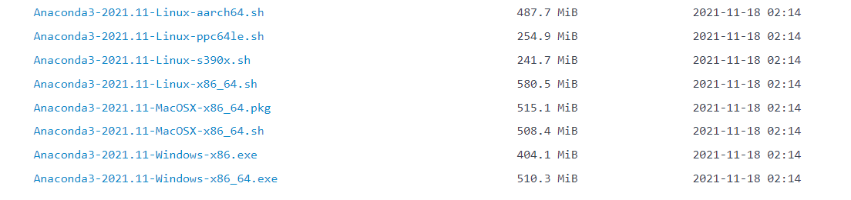
Course data
Software: Anaconda https://mirrors.tuna.tsinghua.edu.cn/help/anaconda/

Slide 12
Course data
HILab newbie training projects

Slide 13
Question 1
Define a function
Factorial of n: n!=1×2 ×…×n
Test cases
5
12
0
-1
“Hello world”

Slide 14
Question 2
Ask two binary classification questions of a given cancer type, excluding these example questions
Man versus woman
Asian versus Caucasian

Slide 15
Question 3
Define a function: (Sample, Class, Feature, Matrix) = fLoadDataMatrix(FileName)
 | f1 | F2 | Class
S1 | 0.5 | 1.9 | 1
S2 | 3.2 | 0.8 | 0

Slide 16
Question 4
Find the top 10 ranked features, and print their names.
(Tvalue, Pvalue) = stats.ttest_ind(dataP, dataN)
Data file: ALL3.txt

Slide 17
Question 5
Dot plots of t-test based
Rank-1 vs Rank-2
Rank-9 vs Rank-10
Rank-1000 vs Rank-1001
Rank-10000 vs Rank-10001
Data file: ALL3.txt

Slide 18
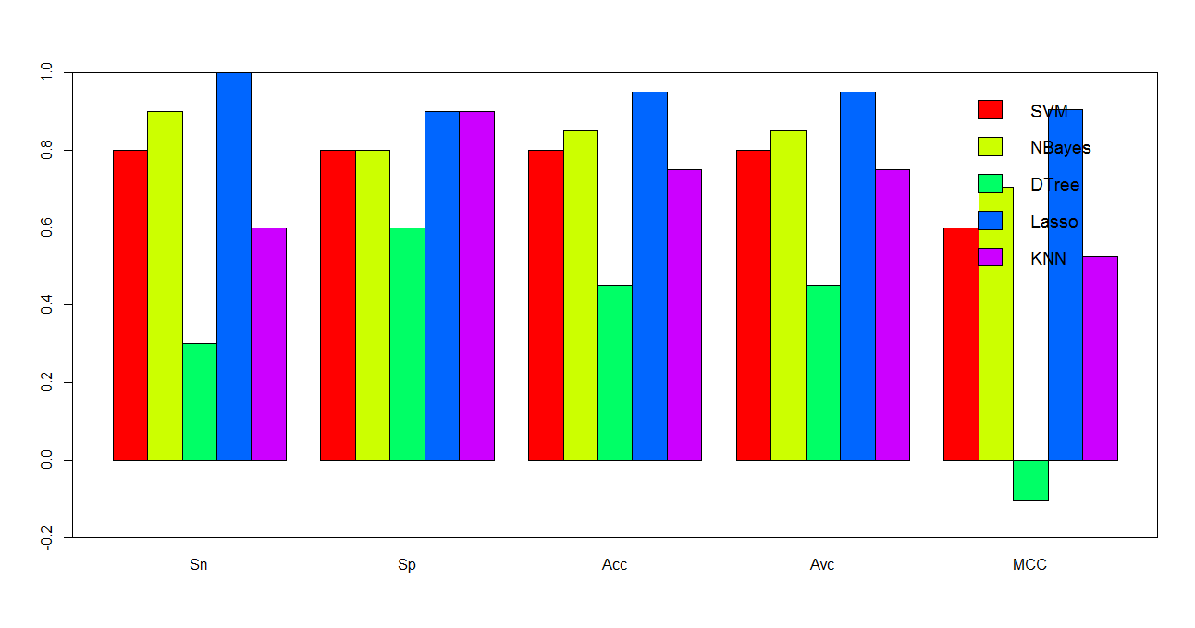
Question 6
Histogram of SVM/Nbayes/KNN
Top-1
Top-10
Top-100
Bottom-100
Data file: ALL3.txt

Slide 19
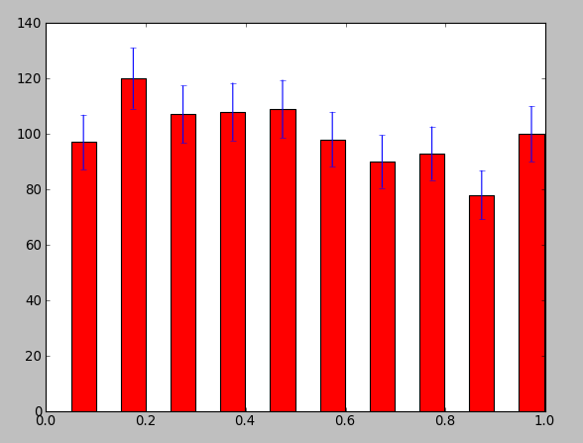
Question bonus
Histogram of SVM/Nbayes/KNN
Top-1
Top-10
Top-100
Bottom-100
10 random runs for the error bars
Data file: ALL3.txt
import numpy as np
import pylab as plt
data = np.array(np.random.rand(1000))
y,binEdges = np.histogram(data,bins=10)
bincenters = 0.5*(binEdges[1:]+binEdges[:-1])
menStd = np.sqrt(y)
width = 0.05
plt.bar(bincenters, y, width=width, color='r', yerr=menStd)
plt.show()
https://stackoverflow.com/questions/11774822/matplotlib-histogram-with-errorbars

Slide 20
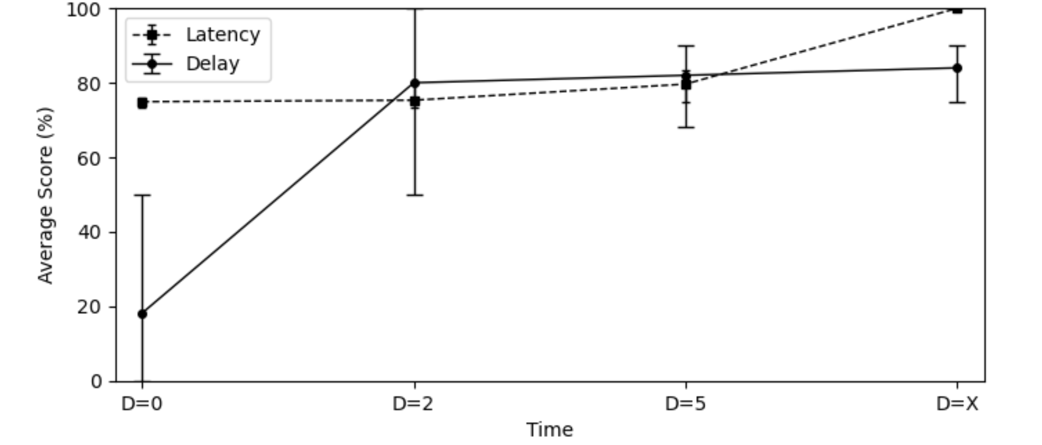
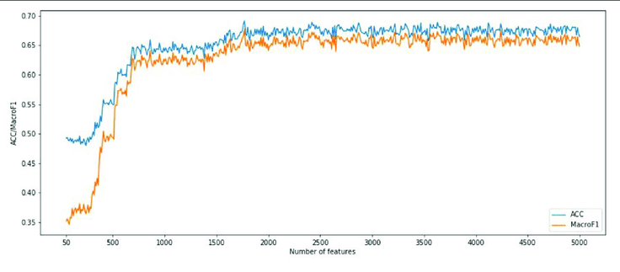
Question bonus
Incremental Feature Selection of SVM/Nbayes/KNN
Top-ranked 100 features
Line plot
10 random runs for the error bars
Data file: ALL3.txt
https://stackoverflow.com/questions/63419636/show-error-bar-in-multi-line-plot-using-matplotlib?r=SearchResults&s=13|106.7049

Slide 21
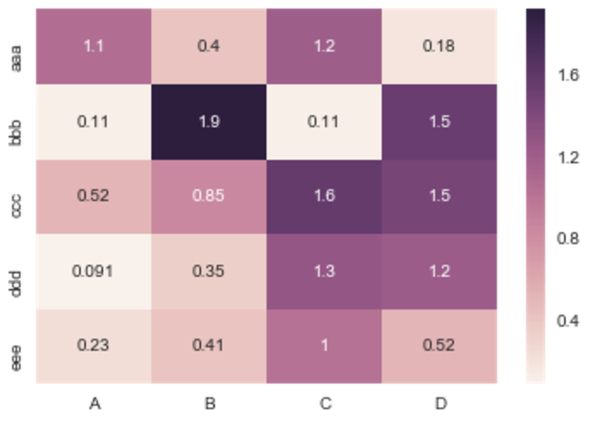
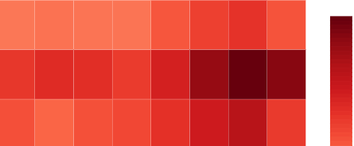
Question bonus
Incremental Feature Selection of SVM/Nbayes/KNN
Top-ranked 100 features
Heatmap
Data file: ALL3.txt
SVM
1.0
Nbayes
KNN
0.6
1 2 3 4 5 6 7 8
Number of features
https://stackoverflow.com/questions/12286607/making-heatmap-from-pandas-dataframe?r=SearchResults&s=2|95.1606

Slide 22
Question 7
Start your course project, if you have not!
The date of the final will be determined on the last class of rehearsal.
You are already working on your course project, if you did the six take-home tests step-by-step.

Slide 23
Question 8
Presentation of your team project

Slide 24
What you can do after this course
基本要求
读取数据
特征选择
二分类
鼓励尝试
特征处理
特征分组
特征工程
特征选择
机器学习
模型优化
样本扩增
去噪音
功能分组
手工设计
过滤法
有监督
参数调优
缺失处理
聚类分组
遗传规划
包装法
半监督
迁移学习
高维初筛
专家分组
深度学习
群体优化
无监督
强化学习

Slide 25


Data science – financial big data
Trends of stock market
Bankruptcy risk
Long term and short term benefits of a stock

Slide 26

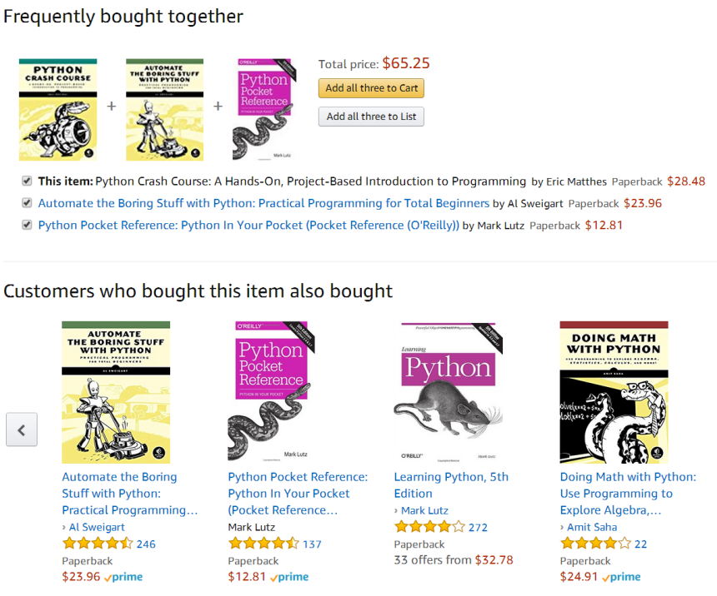
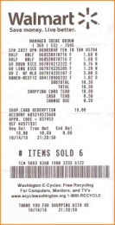
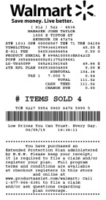
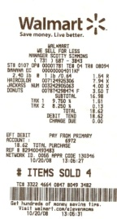

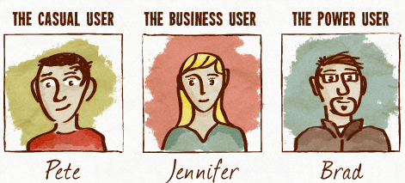
Data science – marketing big data
Advertise similar items
Recommend “you may like” items
Send discount codes for items not immediately needed

Slide 27
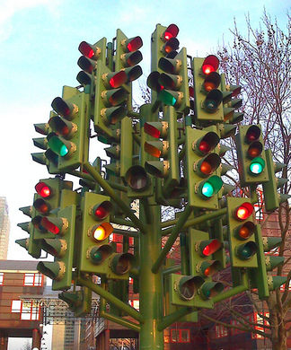

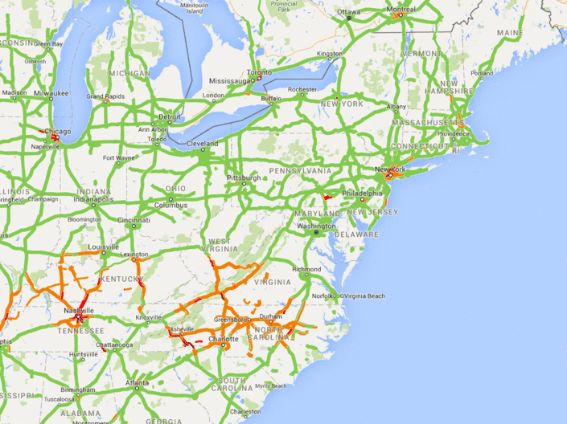
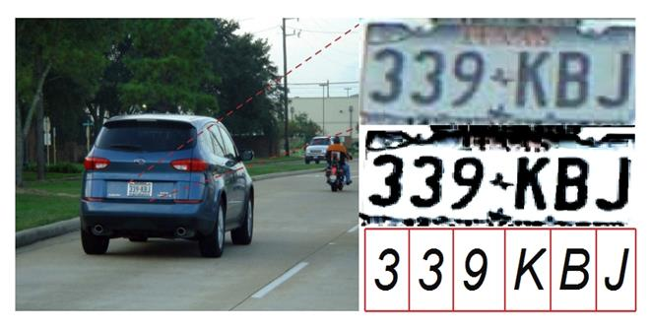
Data science – traffic big data
Monitor traffic and predict traffic loads in advance
Detect the license plat data of speeding cars
Recommend better navigation routes

Slide 28


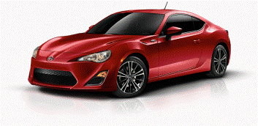



Data science – credit big data
3.0% or 5.8%
0.1% or 10.1%
Determine the amount and interest of a loan
Approve a credit card with better benefits
Rent an apartment or even get a decent job

Slide 29


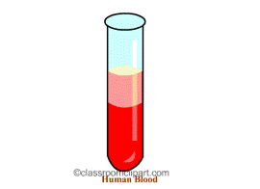
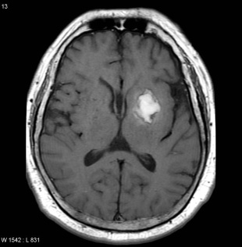




Data science – biomedical big data
Determine disease lesion sites, best treatments, and personal disease risks, etc.
Detect personal talents
Well, a possibility needs to be achieved by hard working!

Slide 30


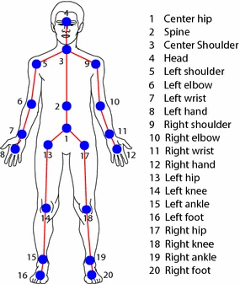

Data science – entertainment big data
Predict audience interests
Effective ad targeting
Predicting gait popularity

Slide 31
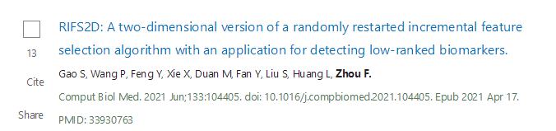
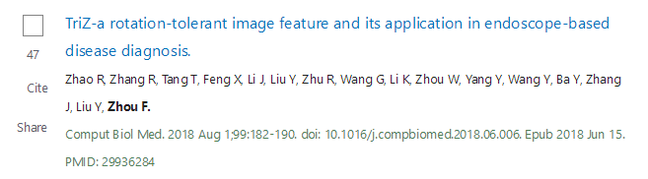
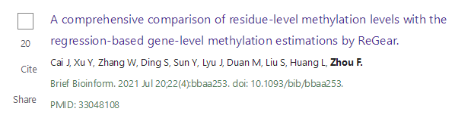
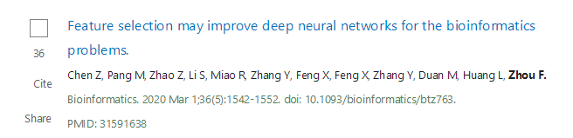
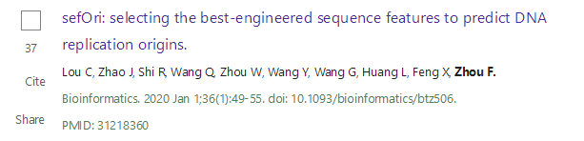
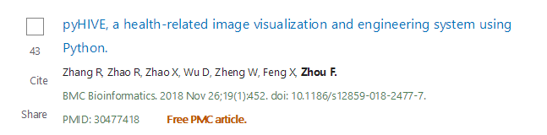
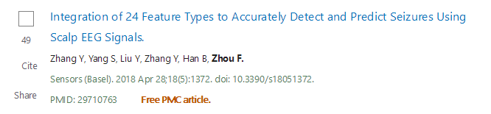
You are the next undergrad that I’m proud of!

Slide 32
Team project requirements
Fengfeng Zhou
Email: FengfengZhou@gmail.com or ffzhou@jlu.edu.cn
HILab, JLU
Web: http://healthinformaticslab.org/ffzhou/

Slide 33
Homework 7 – pipeline
Combine your Python scripts of the previous homework into a pipeline, with the following requirements
One main interface script with all the functional modules integrated, all parameters in one config file
Report all the results as output files
A manual document
Remember to project an example data file! So that I can run the script directly.

Slide 34
Homework 7 – pipeline (1)
One main interface script with all the functional modules integrated, all parameters in one config file with the command line:
python ./pipeBinClass.py pbc.conf
# Configuration for a binary classification project
# Team leader: XXX (student number)
# Team member: YYY (student number)
# Contact: TeamLeader-Email
# Date: 2020-05-08
Input: DataMatrix.csv
OutputDir: output-dir
# config for t-test
MaxFeature: 20
# Dot-plot
DP-ImageFormat: JPG
DP-DOI: 300
DP-Output: Hello1.jpg

Slide 35
Homework 7 – pipeline (2)
Report all the results as output files (in the output directory “output-dir”)
Features ranked by t-test in a text file
Dot-plot image files
Histogram image files
…

Slide 36
Homework 7 – pipeline (3)
A manual document
Describe the syntax of the configuration file
Describe the output data files

Slide 37
Homework 8 – team project
Documents of the team project
PPT (with all members’ names, student numbers, who is the team leader)
The pipeline and configuration file used to generate this PPT
Data file

